Slide 1
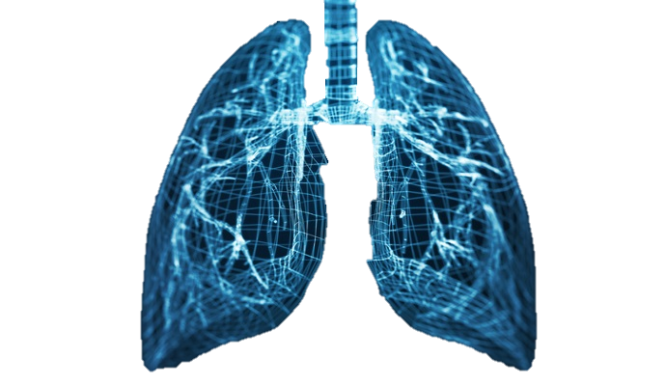

Lung Cancer prediction System
Using Deep Learning
Heba Abu-Shareefeh 2019980186
Rudaina Alyasein 2019980261
Mohammed Mrayyan 2019980212
Supervisor: Dr.Mahmoud Massadeh
Computer Engineering Department

Slide 2
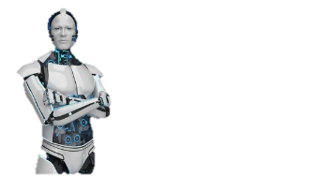
Introduction
Lung Cancer Diagnosis Challenging
High rate of Death.
Time and effort needed to Diagnosis.
The poor outcomes in patients with lately stages.
Early detection of lung cancer can lead to better treatments and outcomes

Slide 3
Introduction
How we Solved this Challenges
Lung Cancer Prediction System is a web-based platform designed to help doctor prediction lung cancer in early stage
Through its user-friendly interface, healthcare professionals can securely upload medical CT scans images, for analysis
The system employs deep learning algorithm (CNNs) to process the images and provide predictive probabilities of lung cancer presence

Slide 4
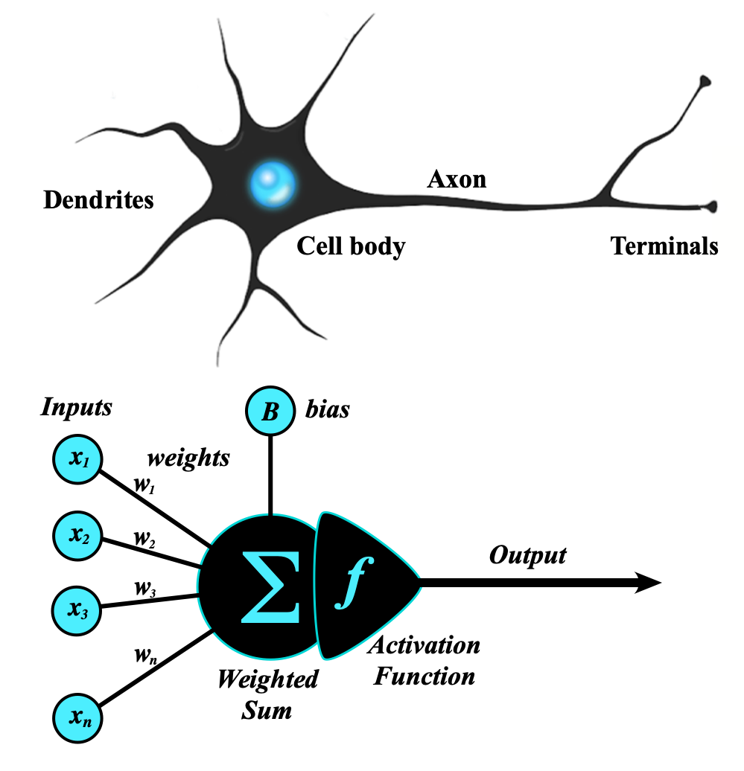
Deep Learning
Deep learning is the subset of machine learning methods based on neural networks.
It works like human’s neurons
Train the DL model on CT-Scan Images to gain experience from them, and then use it to predict the probability of Lung Cancer for new unseen images.

Slide 5
Steps
Data Collecting
Data Preparing
Model Building
Validation
Evaluation
Deployment

Slide 6
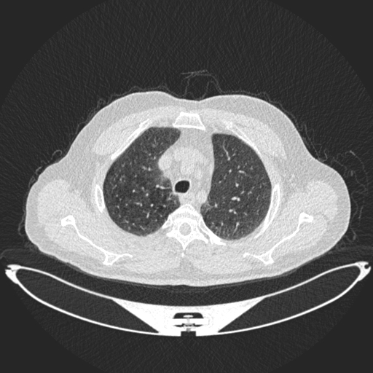
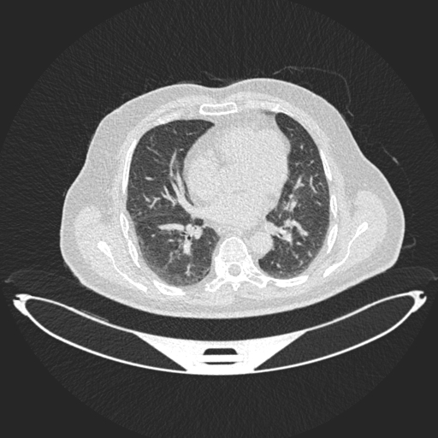
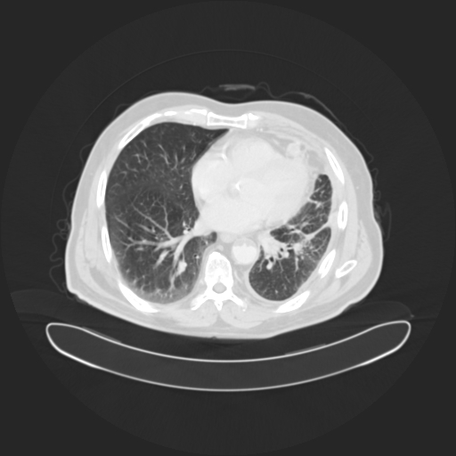
Data Collecting
We used Image Dataset from Kaggle.
It contains 1097 images grouped into 3 classes.
Samples from the dataset:

Slide 7
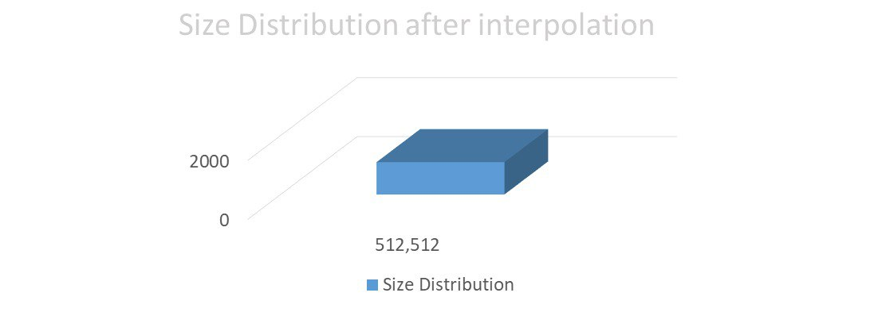
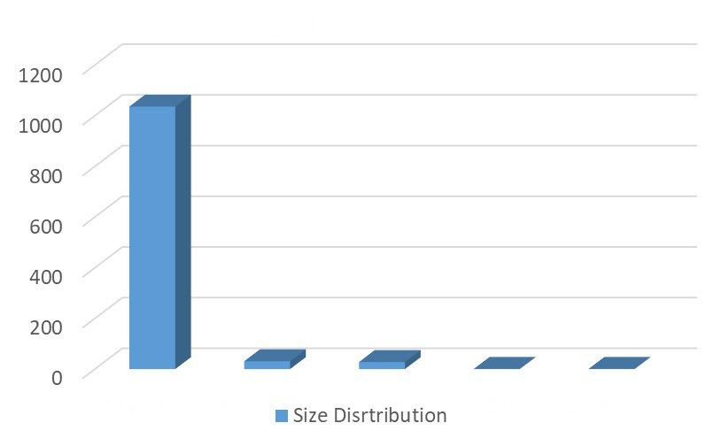

Data Preparing
Resizing
1097
1036
1097
31
28
1
1

Slide 8
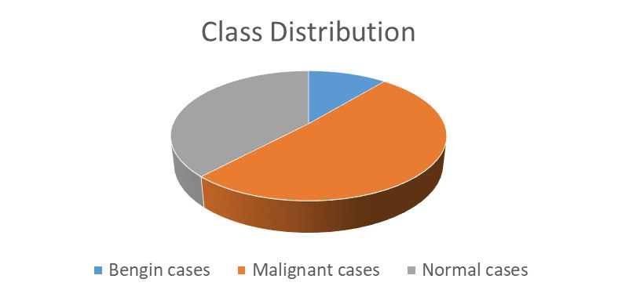
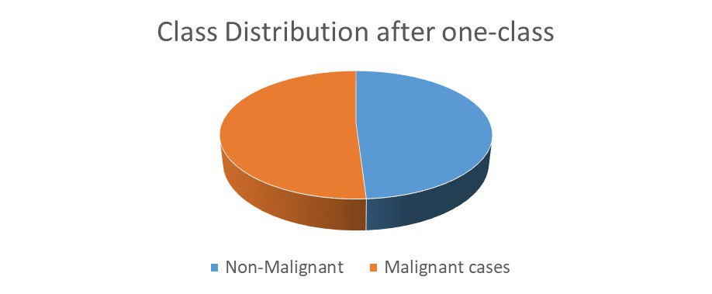
Data Preparing
Balancing the data using One-Class classification

Slide 9
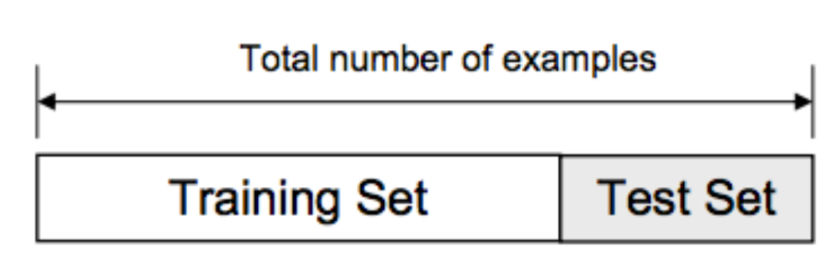
Data Preparing
Splitting Dataset to train and test
Training Set used for train the model.
Testing Set used for evaluation.
70%
30%

Slide 10
Data Preparing
Data Encoding
Computer can’t work with string directly.
Convert categorical values to numeric.

Slide 11
Convolutional Neural networks CNNs
CNNs:
Type of neural network Architecture that is widely used for performing deep learning on image data.
CNN consists of an input layer, a hidden layer(s), and an output layer
the hidden layers of a CNN consist of a special series of layers called the convolutional and pooling layers (Feature Extraction).

Slide 12
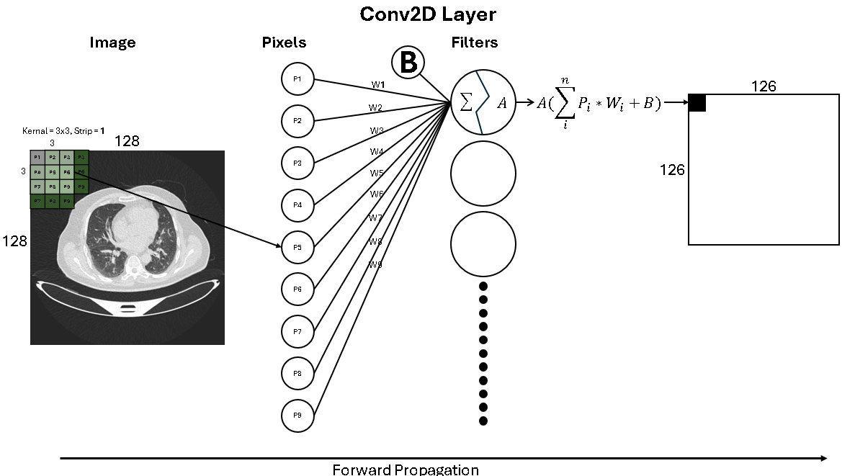
Convolutional Neural networks CNNs
Conv2D Layer
Starting with random kernal.
Applying the kernal on the input.
It works as filter.
Find the optimal kernal.

Slide 13
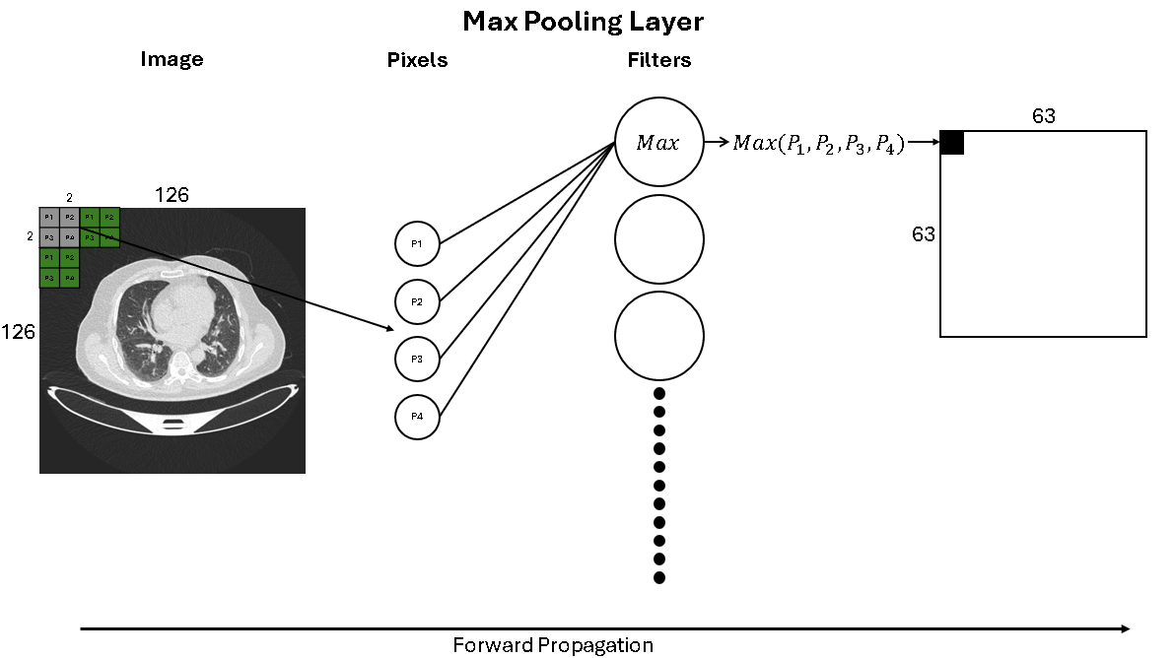
Convolutional Neural networks CNNs
Max Pooling
It used to decrease the size of image
Increase the speed of training

Slide 14
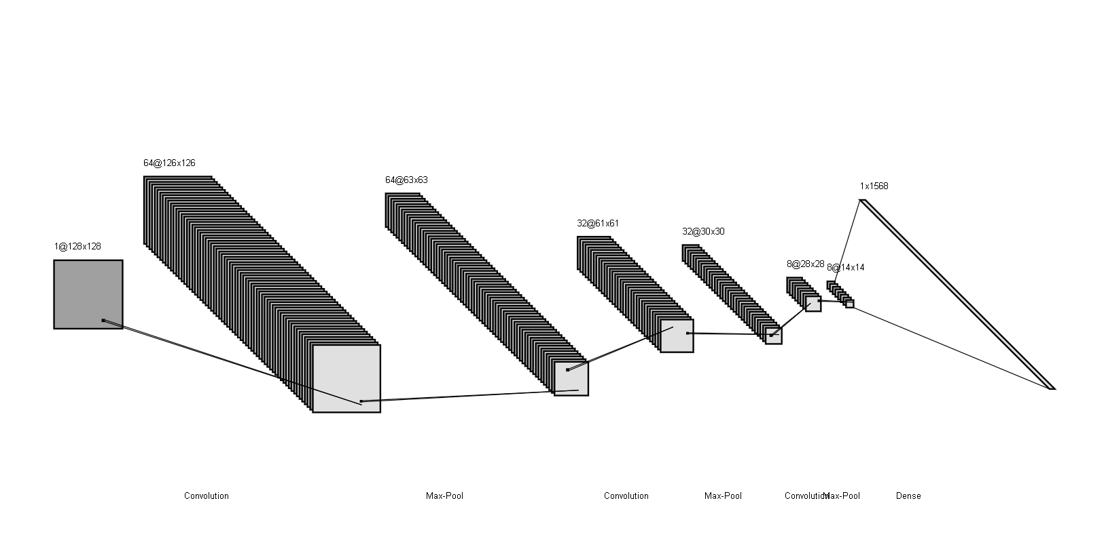
Model Structure
Our model consists of 3 conv2D, 3 Max Pooling, 1 Flatten and 1 Dense Layer

Slide 15
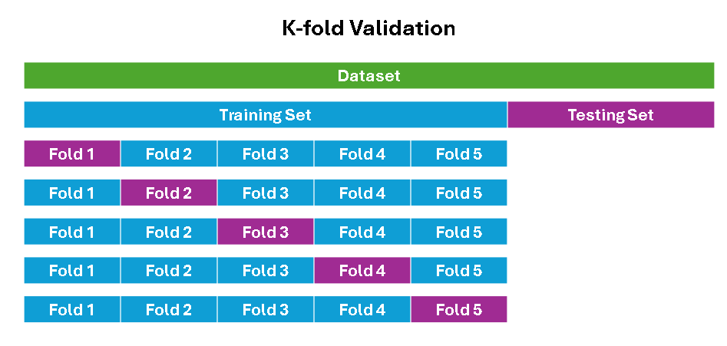
Hyperparameter Tuning
We used GridSearchCV
It’s a technique to find the best parameters by trying different combinations.
CV stands for K-fold Cross validation
This phase takes 1 hour of running to try 108 different combinations.

Slide 16
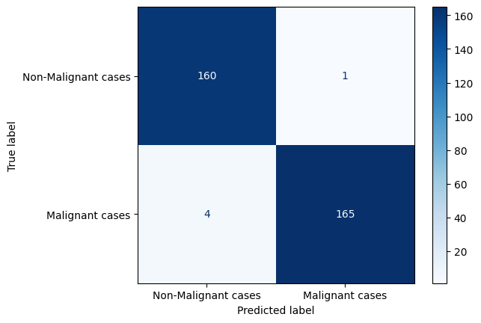
Evaluation
Confusion Matrix
Accuracy: 99.091%
Sensitivity: 99.379%
Precision: 97.561%
F1 Score: 98.462%

Slide 17
Web
We used Web with AI to design a beautiful, intuitive user interface that meets the user’s requirements. We also followed the companies’ policy of dividing the team, where part of the team knew the web, so it had a front-end part, and the other part was specialized in deep learning.

Slide 18
User Interface
Front End
The process of building components that interact with users.
In our front-end design phase, our goal was to create a responsive website that functions seamlessly across all devices, while enhancing user Experience through a focus on their needs and ensuring compatibility.
We utilized HTML, CSS, JavaScript, and Bootstrap to develop the front-end.

Slide 19
User Interface
API
Stands for Appliacation Programming Interface.
helps two programs or applications to communicate with each other by providing them with the necessary tools and functions. It takes the request from the user and sends it to the service provider and then again sends the result generated from the service provider to the desired user.
We Used Flask Framework to connect a web application with Deep Learning Model.

Slide 20
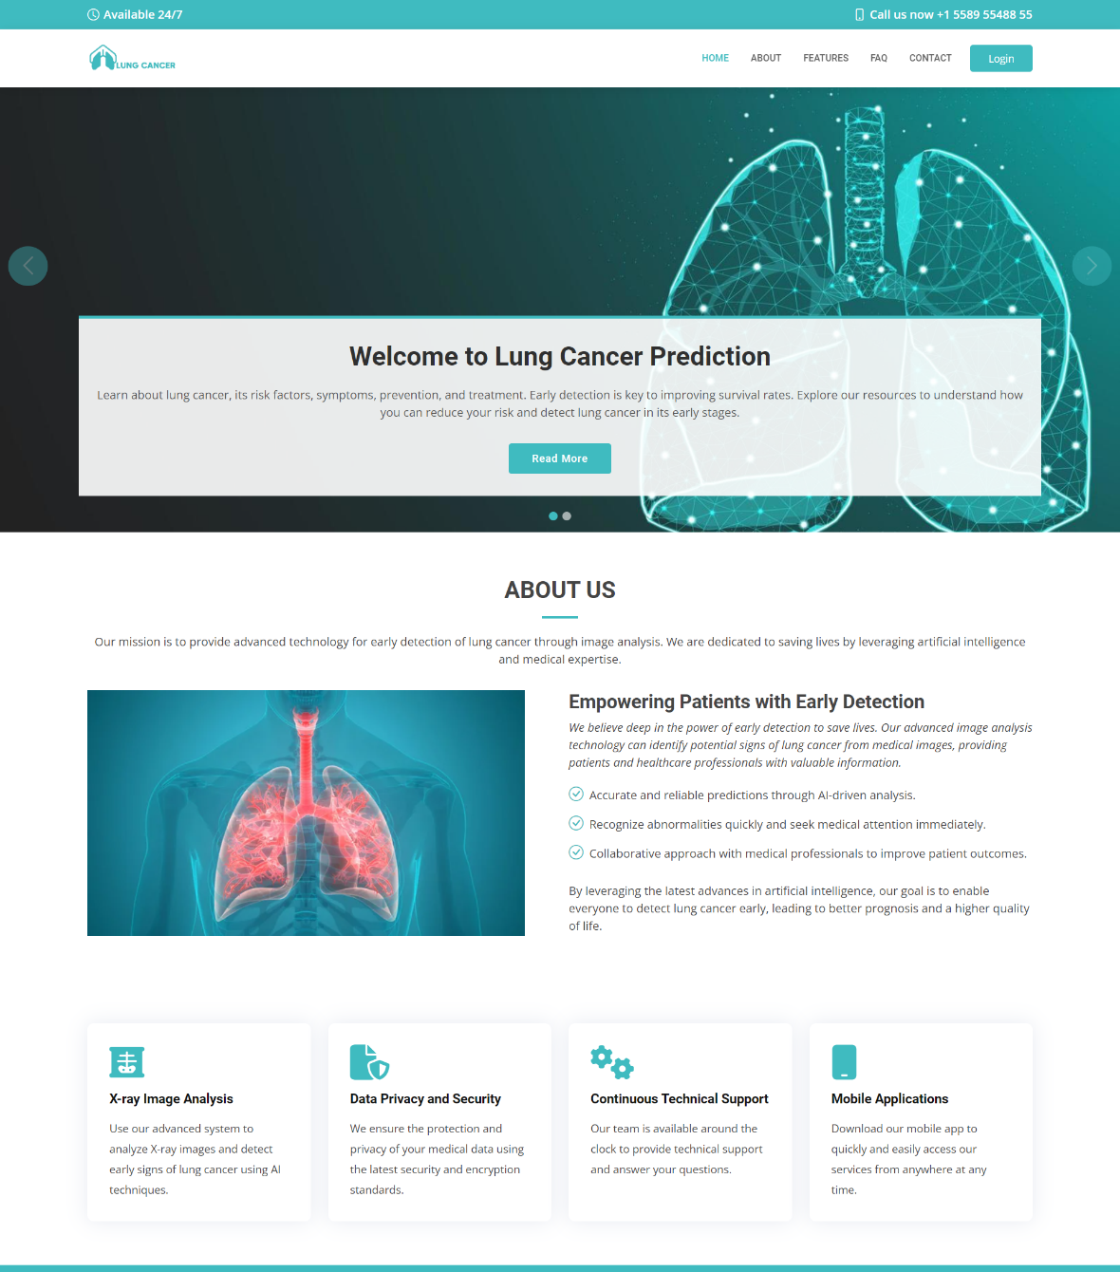
Home Page

Slide 21
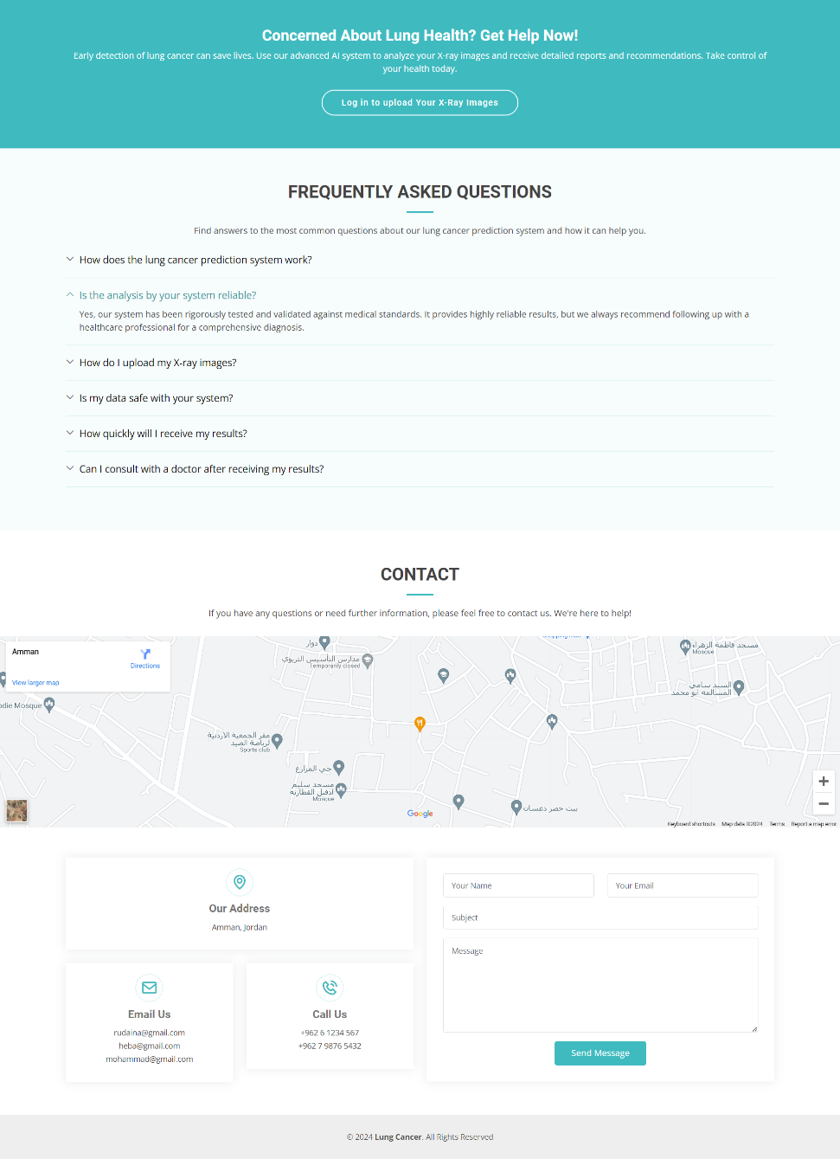
FAQ,Contact Page

Slide 22
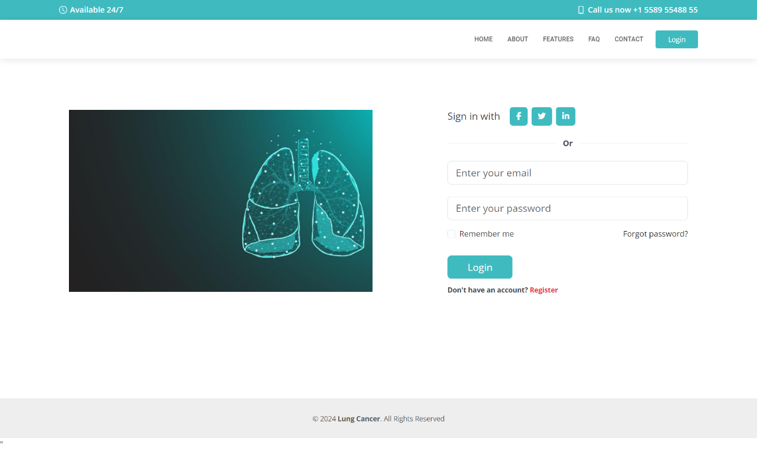
Sign in Page

Slide 23
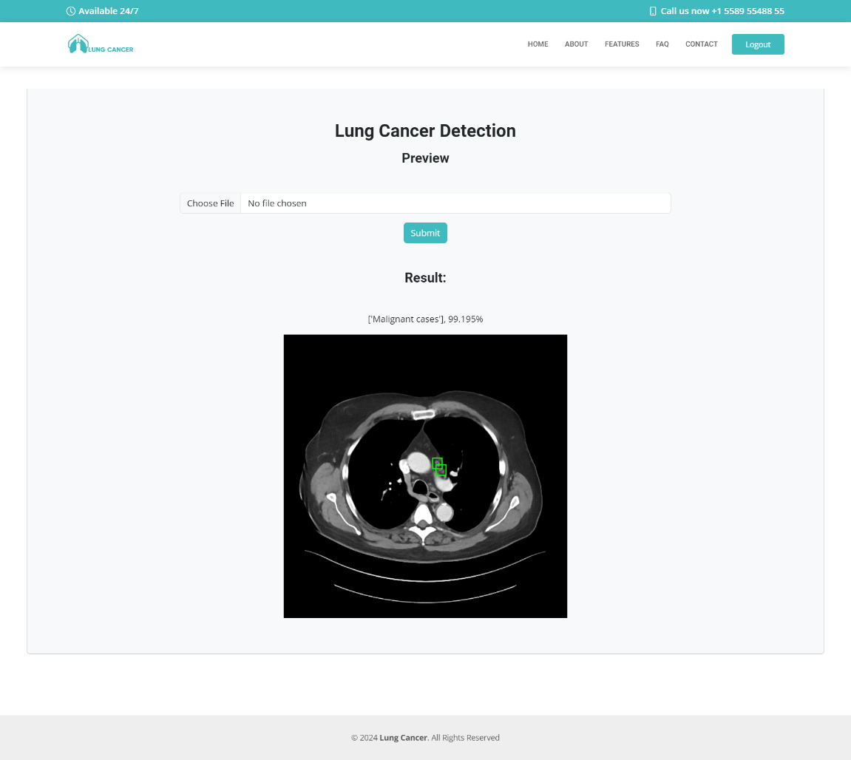
Result Page

Slide 24

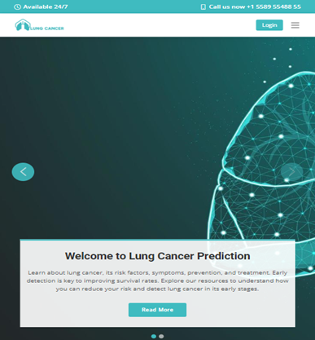
Responsive Website

Slide 25
Future Work
Enhance the mode to get higher precision.
New model to detect the location of Cancer
Improve the dataset to contain the patient records
New models for another diseases.

Slide 26
References
Deep Learning (DL) - Questions and Answers ​in MRI (mriquestions.com)
NN SVG (alexlenail.me)
CNN Explainer (poloclub.github.io)
The IQ-OTH/NCCD lung cancer dataset | Kaggle
New respiratory airway secretory (RAS) cells discovered inside lungs | SYFY WIRE
Yarmouk University (yu.edu.jo)

Slide 27
Thank You

